Slide 1
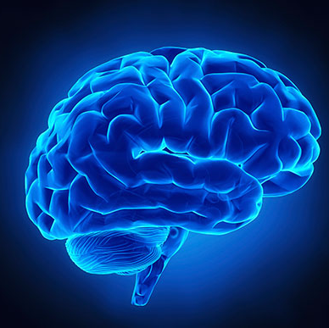
Brain Tumour Detection System

Slide 2
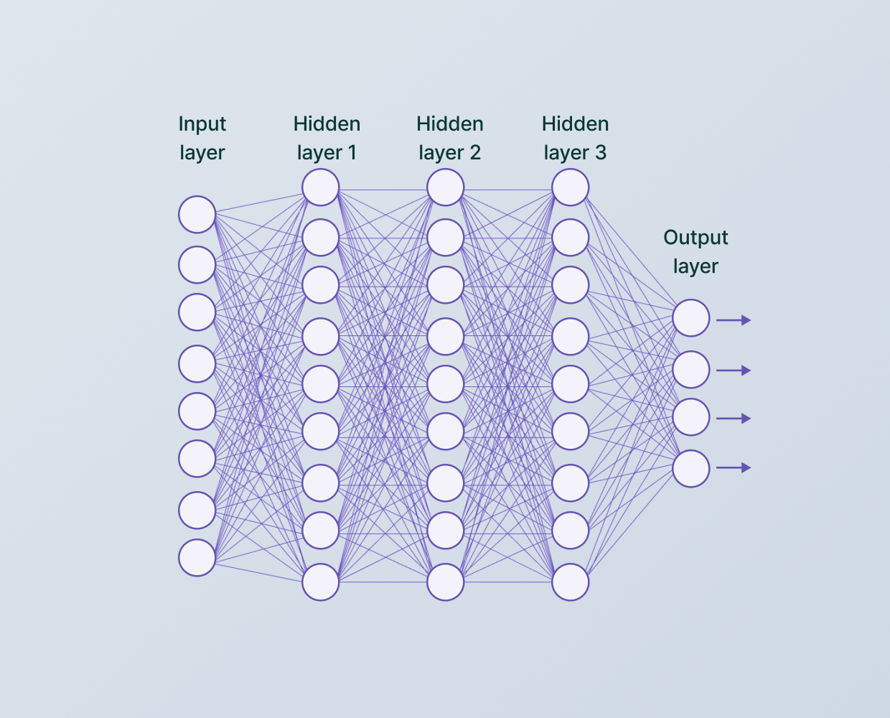
Introduction
Website Overview: This website is designed to utilize Convolutional Neural Network (CNN) technology to predict brain tumors using MRI scans.
CNN Technology: CNN technology is a deep learning algorithm that is specifically designed for image recognition and classification tasks. In the context of this website, CNN is used to analyze MRI scans of the brain and identify the presence of tumors.

Slide 3
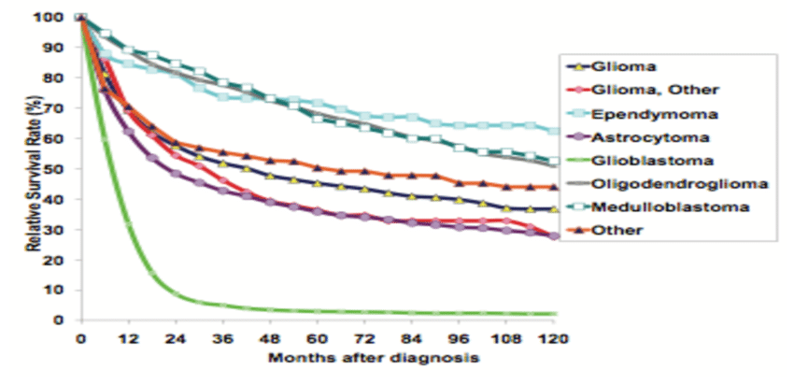
Importance of Early Detection
Early detection of brain tumors using CNN technology is crucial for timely intervention, improving patient outcomes, and reducing treatment complexities, enhancing the chances of successful treatment and recovery.
Utilizing CNN in brain tumor detection projects facilitates swift and accurate identification, enabling healthcare professionals to implement targeted interventions, potentially saving lives and minimizing the impact of neurologic disorders.

Slide 4

CNN Algorithm
The website uses a Convolutional Neural Network (CNN) algorithm to process MRI scans and accurately predict brain tumors. The CNN algorithm is a deep learning model specifically designed for image classification tasks.The CNN algorithm consists of multiple layers, including convolutional layers, pooling layers, and fully connected layers. These layers work together to extract meaningful features from the input MRI scans and make predictions based on those features.

Slide 5
Simplified process
Input MRI scans are fed into the CNN algorithm.
The convolutional layers apply filters to the input scans, extracting features such as edges, textures, and shapes.
The pooling layers downsample the extracted features, reducing the spatial dimensions while preserving the important information.
The fully connected layers take the downsampled features and learn to classify them into different tumor categories.
The output layer produces the predicted tumor category based on the learned features.

Slide 6
Data Collection and Preprocessing
To train our CNN model, we collected a large dataset of MRI scans of patients diagnosed with brain tumors from kaggle.
To ensure the accuracy of tumor predictions, we performed several preprocessing steps on the collected MRI data. These steps included:
Rescaling the intensity values of the MRI scans to a standardized range.
Removing noise and artifacts from the scans using advanced filtering techniques.
Segmenting the brain region from the MRI scans to focus on the tumor area.
Augmenting the dataset by applying transformations to the MRI scans, such as rotations and translations.

Slide 7
Training and Testing
Training the CNN Model:
The CNN model is trained using a portion of the labeled MRI data. The training process involves feeding the images into the network and adjusting the weights and biases of the model to minimize the prediction error.
Testing the CNN Model
The trained CNN model is then tested using a separate portion of the labeled MRI data that was not used during training. This allows us to evaluate the model's performance and accuracy in predicting brain tumors.

Slide 8
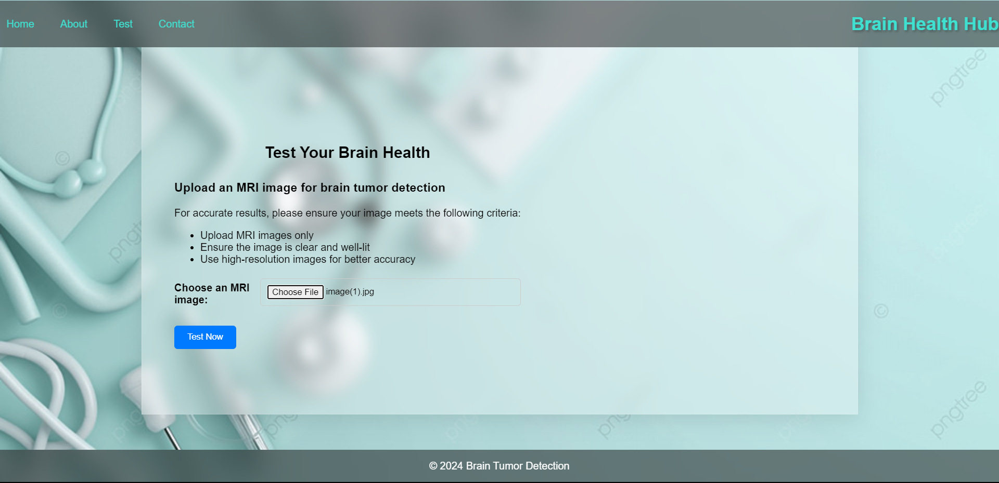
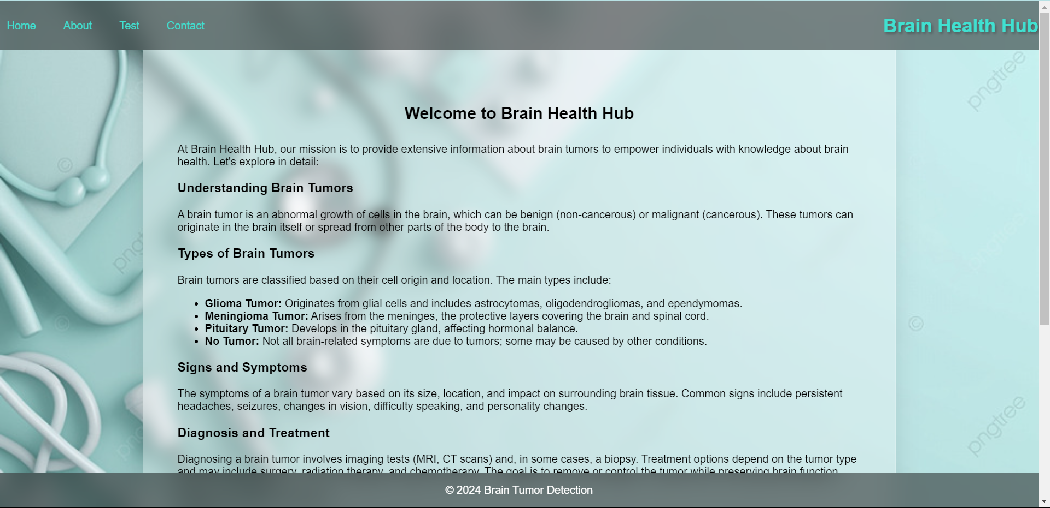
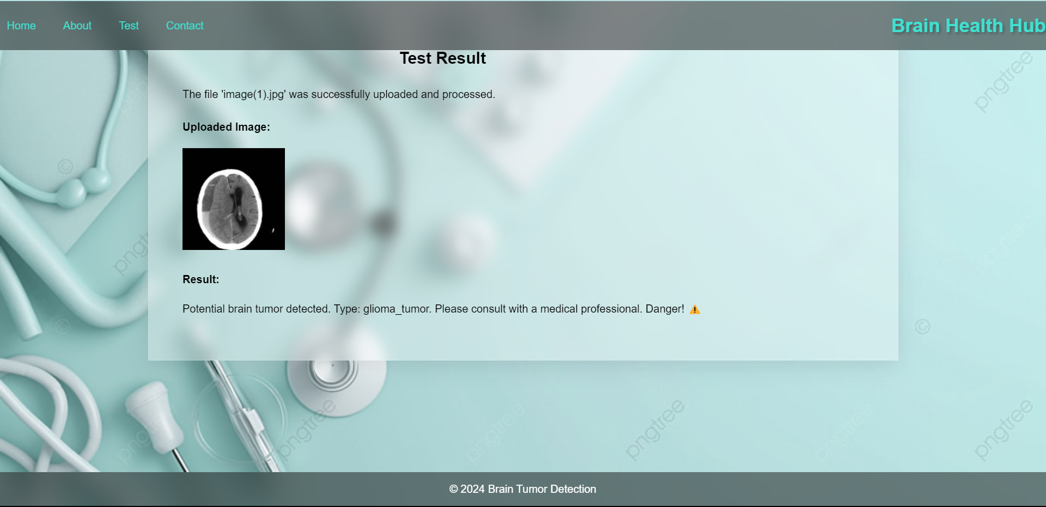
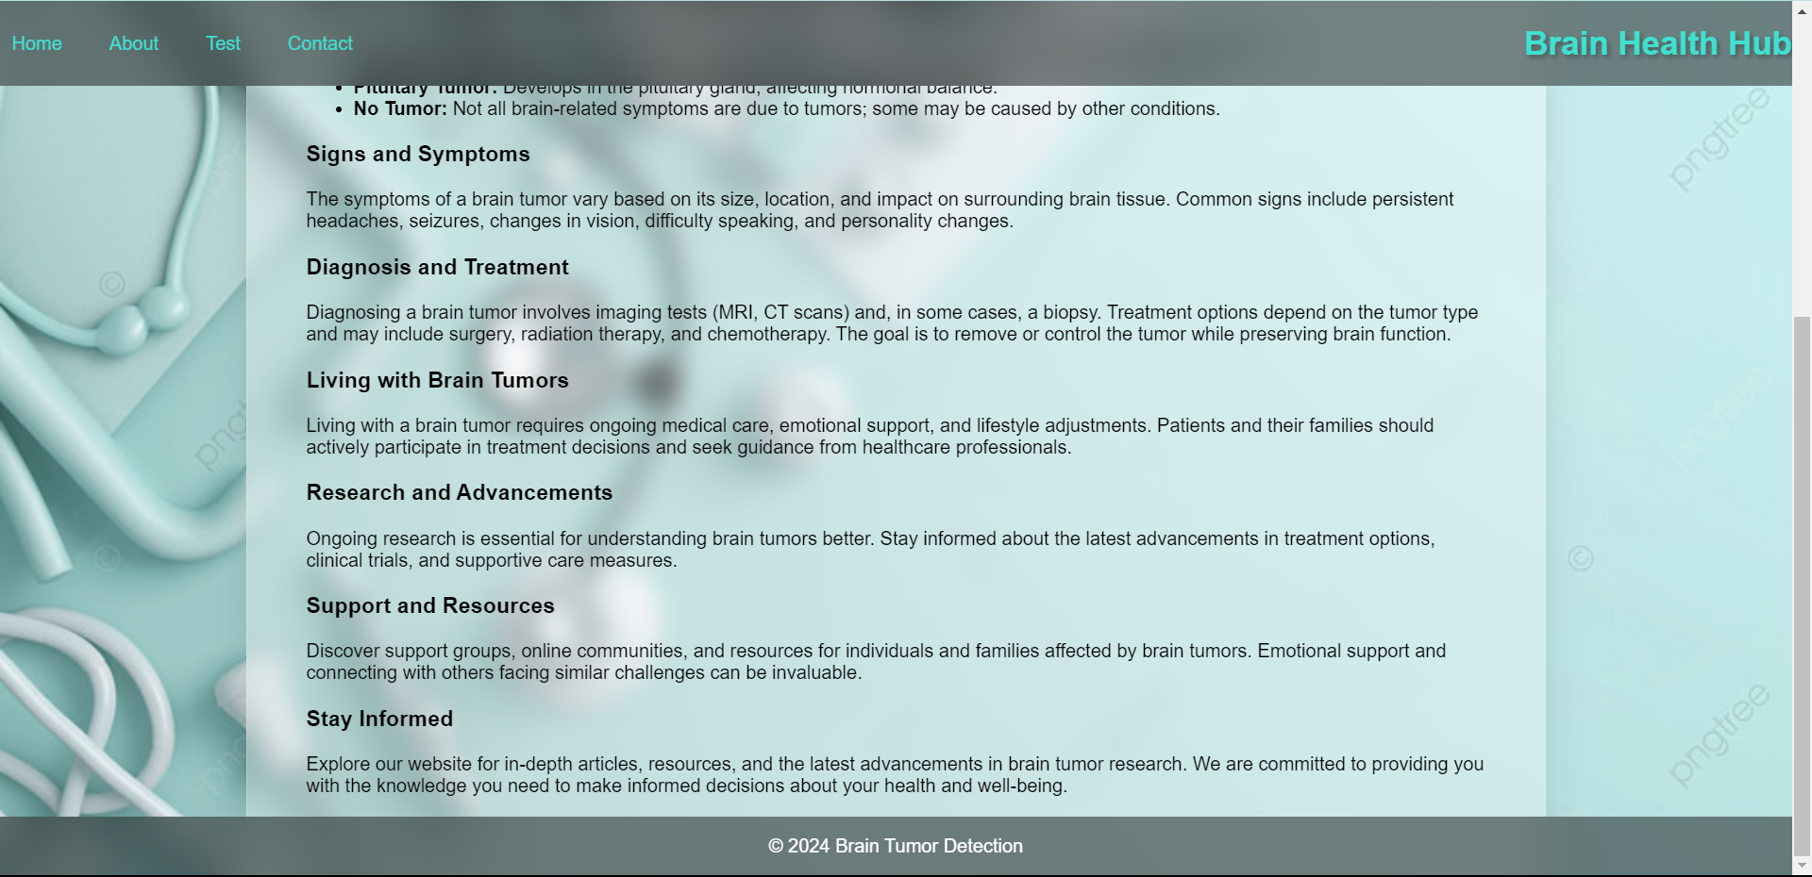
Demonstration

Slide 9
Benefits and Features
Automatic Tumor Segmentation
The website uses advanced CNN algorithms to automatically segment brain tumors in MRI scans.
Precision in Tumor Localization
The website accurately localizes the tumor within the brain, providing precise information for diagnosis and treatment planning.
Speed of Prediction
The website provides fast and real-time predictions, allowing for quick decision-making and timely intervention.

Slide 10
Conclusion
In conclusion, our CNN-based brain tumor detection project demonstrates the potential of advanced technology in medical diagnostics, offering a more accurate and efficient means of identifying abnormalities.
By leveraging convolutional neural networks, we have achieved remarkable results in automating the detection process, paving the way for early intervention and improved patient outcomes in the realm of neuroimaging.
This project underscores the significance of integrating artificial intelligence into healthcare, showcasing the transformative impact of CNNs in enhancing the speed, precision, and accessibility of brain tumor detection for better healthcare delivery.

Slide 11
THANK YOU

